Slide 1
Scalable many-light methods
Jaroslav Křivánek
Charles University in Prague

Slide 2
Instant radiosity
Approximate indirect illumination by
Virtual Point Lights (VPLs)
Generate VPLs
Render with VPLs

Slide 3
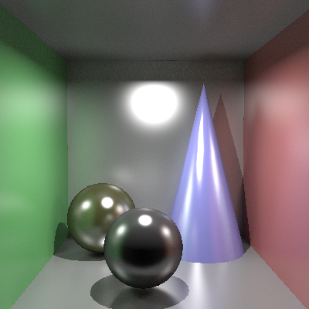
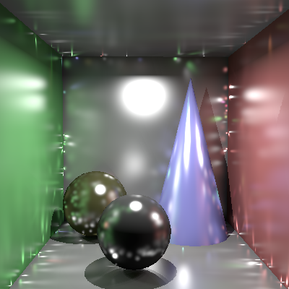
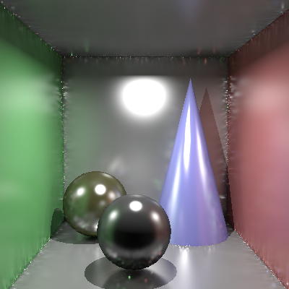
Instant radiosity with glossy surfaces
Large number of VPLs required
  True even for diffuse scenes
  Scalability issues
Ground truth
1,000 VPLs
100,000 VPLs

Slide 4
Scalable many-light methods
Generate many, many VPLs
Pick only the most relevant VPLs for rendering

Slide 5
Scalable many-light methods
Choosing the right VPLs
  Per-pixel basis
    Lightcuts [Walter et al 05/06]
  Per-image basis
    Matrix Row Column Sampling [Hašan et al. 07]
  Somewhere in-between
    LightSlice [Ou & Pellacini 2011]
    Importance caching [Georgiev et al. 2012]

Slide 6
Scalable many-light rendering
Lightcuts
Multidimensional Lightcuts
Walter et al., SIGGRAPH 2005/2006
Slides courtesy Bruce Walter:
http://www.graphics.cornell.edu/~bjw/papers.html

Slide 7
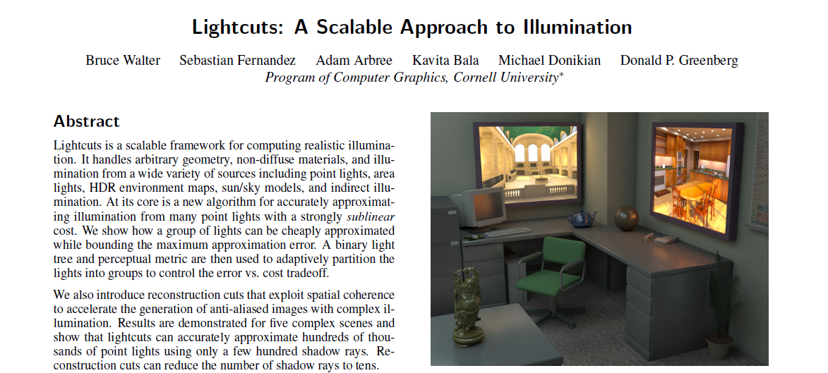
Lightcuts
http://www.graphics.cornell.edu/~bjw/papers.html

Slide 8
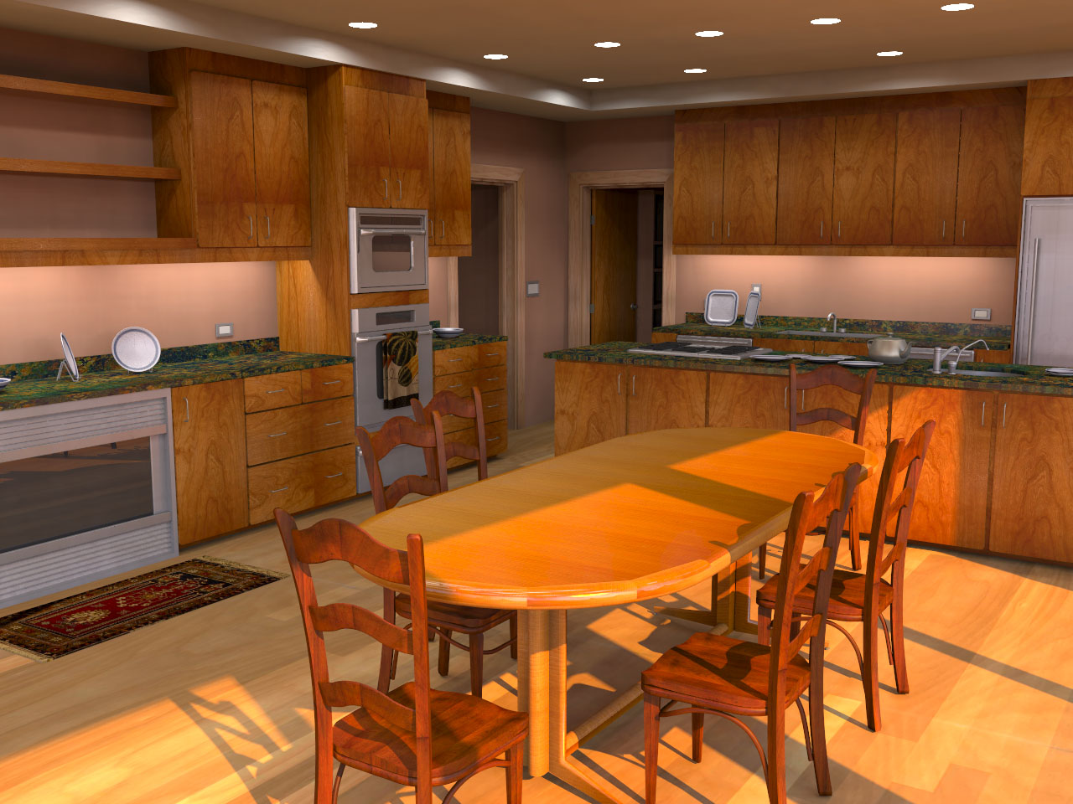
Complex Lighting
Simulate complex illumination using VPLs
  Area lights
  HDR environment maps
  Sun & sky light
  Indirect illumination
Unifies illumination
Area lights + Sun/sky + Indirect
Notes:
Once we have a scalable solution for many point lights, we can use this to compute other types of complex illumination. The four examples we demonstrate in the paper are area lights, high dynamic range environment maps, sun & sky light, and indirect illumination. Moreover this allows us to unify the handling of different illumination types and enables new types of tradeoffs. For example, bright illumination from one source allows coarser approximations of other sources.

Slide 9
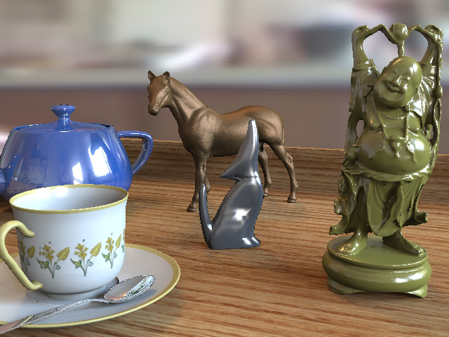
Scalable
Scalable solution for many point lights
  Thousands to millions
  Sub-linear cost
Tableau Scene
Notes:
The core of lightcuts is a new scalable algorithm for efficiently approximating the light from many point lights. By many I mean thousands to millions. Here we show the time to compute this tableau scene with environment map illumination using varying numbers of lights. Evaluating each light individually gives a cost that increases linearly with the number of lights. Using Ward’s technique we can avoid shadow to some of the weaker lights, but the cost is still basically linear. However lightcuts cost is strongly sub-linear. Thus its advantage over previous techniques grows dramatically as the number of lights increases.

Slide 10
Lightcuts Problem
Visible
surface
Notes:
First let’s formulate the lightcuts problem. Give a visible surface point and a large collection of point lights.

Slide 11
Lightcuts Problem
Notes:
We want to compute how much light reaches the visible surface

Slide 12
Lightcuts Problem
Camera
Notes:
And is reflected to a camera.

Slide 13
Key Concepts
Light Cluster
  Approximate many lights by a single brighter light
  (the representative light)
Notes:
There are a few key concepts we need to understand the lightcuts approach. First is a light cluster where we approximate a group of lights by replacing them by a single brighter light called the representative light.

Slide 14
Key Concepts
Light Cluster
Light Tree
  Binary tree of lights and clusters
Clusters
Individual
Lights
Notes:
Second is the light tree which is a binary tree of lights and clusters. The leaves of this tree are the individual lights while the interior nodes represent clusters which get progressively larger as we go up the tree.

Slide 15
Key Concepts
Light Cluster
Light Tree
A Cut
  A set of nodes that partitions the lights into clusters
Notes:
The third is a cut which is a set of nodes that partitions the lights into clusters. Here illustrated by the orange line.

Slide 16
Simple Example
Light Tree
Representative
4
#1
#2
#3
#4
Light
Clusters
1
4
1
2
3
4
Individual
Lights
Notes:
Here is a simple scene with four lights and its corresponding light tree.

Slide 17
Three Example Cuts
Three Cuts
#1
#2
#4
#1
#3
#4
#1
#4
4
4
4
1
4
1
4
1
4
1
2
3
4
1
2
3
4
1
2
3
4
Notes:
And here we show three example cuts through the light tree. Highlighted above each cut are the regions where that cut produces an accurate approximation of the exact illumination.

Slide 18
Three Example Cuts
Three Cuts
#1
#2
#4
#1
#3
#4
#1
#4
4
4
4
1
4
1
4
1
4
1
2
3
4
1
2
3
4
1
2
3
4
Good
Bad
Bad
Notes:
If we look at this green point on the left of the images, the orange cut produces a good approximation while the blue and purple cuts would cause too much error.

Slide 19
Three Example Cuts
Three Cuts
#1
#2
#4
#1
#3
#4
#1
#4
4
4
4
1
4
1
4
1
4
1
2
3
4
1
2
3
4
1
2
3
4
Bad
Good
Bad
Notes:
Conversely for this point in the center of the images, the blue cut is a good approximation while the orange and purple cuts are not usable. This illustrates an important point. We will want to use different cuts in different parts of the image.

Slide 20
Three Example Cuts
Three Cuts
#1
#2
#4
#1
#3
#4
#1
#4
4
4
4
1
4
1
4
1
4
1
2
3
4
1
2
3
4
1
2
3
4
Good
Good
Good
Notes:
For this point on the right side of the images, all three cuts usable. In this case the purple cut is the best choice because it will be the cheapest to compute as it contains the fewest nodes.

Slide 21
Algorithm Overview
Pre-process
  Convert illumination to point lights
  Build light tree
For each eye ray
  Choose a cut to approximate the illumination
Notes:
Our algorithm consists of a pre-process where we convert all illumination types to point lights and build the light tree. Then for each eye ray we need to choose an appropriate cut to use.

Slide 22
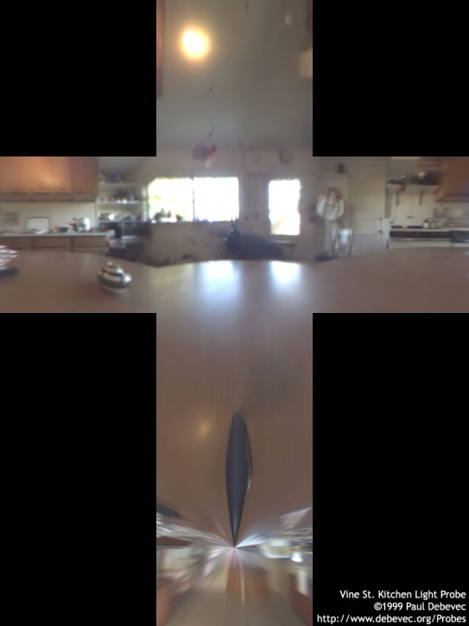
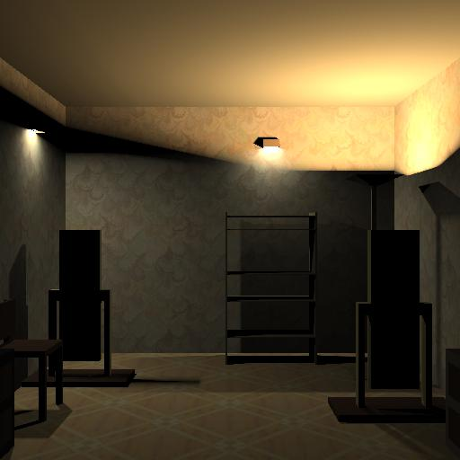
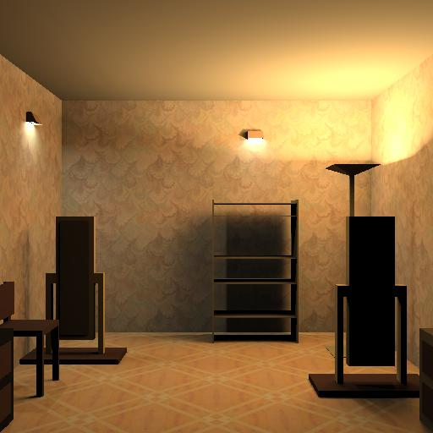
Convert Illumination
HDR environment map
  Importance sampling
Indirect Illumination
  Convert indirect to direct illumination using Instant
  Radiosity [Keller 97]
    Caveats: no caustics, clamping, etc.
  More lights = more indirect detail
Notes:
We use various existing techniques to convert various illumination types to point lights. For environment maps we use the technique of Agarwal et al. For indirect illumination, we use the instant radiosity technique which generates virtual indirect point lights to approximate the indirect illumination. The amount of indirect detail we can capture is directly related to the number of virtual lights created. Thus we want to use lots of lights to accurately simulate the indirect.

Slide 23
  Build light tree
Cluster spatially close lights with similar orientation
Light Tree
Representative
4
Light
Clusters
1
4
1
2
3
4
Individual
Lights
Notes:
Then we build the light tree using a simple greedy approach.

Slide 24
  Choose a cut
Approximate illumination with a bounded error
Different cut for each pixel
Notes:
The more difficult problem is choosing the cuts. There is a cost vs accuracy tradeoff of cuts higher in the tree are cheaper while cuts lower the in tree are more accurate. We also need to avoid transition artifacts. Since we will use different cuts in different parts to the image, there will be transitions between places where we use a cluster and places where we refine it, and we don’t want these to produce visible artifacts. We will actually use this to drive the cut selection.

Slide 25
Illumination Equation
Σ
result = M_{i} G_{i} V_{i} I_{i}
lights
Material term
Visibility term
Geometric term
Light intensity
Notes:
The contribution from a point light can be written as the product of four terms and then summed over all the lights to get the total result. The first term is a material term that depends on the material properties of the visible surface. Our initial implementation supports diffuse, phong and ward materials.
The second term is the geometric term that depends on the position and orientation of the point light.
The third term is the visibility term since some lights may be occluded. And the fourth term is the light’s intensity.

Slide 26
Cluster Approximation
Sum pre-computed
during light tree
construction
result ≈ M_{j} G_{j} V_{j} I_{i}
Σ
lights
j is the representative light
Cluster
Notes:
When we approximate a cluster we use the material, geometric, and visibility terms from the representative light for all the lights. This is much cheaper but introduces some error.

Slide 27
Cluster Error Bound
error < M_{ub} G_{ub} V_{ub} I_{i}
Σ
−
lights
Bound each term
  Visibility <= 1 (trivial)
  Intensity is known
  Bound material and geometric terms using cluster bounding volume
Cluster
ub = upper bound
Notes:
We can bound the approximation error by computing upper bounds for each of the terms over the cluster. Visibility is always less than or equal to one, so we use one as its trivial bound. Intensities are known ahead of time. The challenging part is to cheaply and tightly bound the material and geometric terms. We have come up with such bounds based on the bounding volume of the cluster and these are described in the paper.

Slide 28
Perceptual Metric
Weber’s Law
  Contrast visibility threshold is fixed percentage of signal
  Used 2% in our results
Ensure each cluster’s error < visibility threshold
  Transitions will not be visible
  Used to select cut
Notes:
We can use Weber’s law which say the the minimal visible change is roughly a fixed percentage of the total signal. For our results we used a threshold of 2%. We can ensure that cluster transitions are not visible by guaranteeing that the clusters error always be less than this threshold. But we will need to be able to put an upper bound on the error introduced by a cluster.

Slide 29
Perceptual Metric
Problem:
  We don’t know the illumination so we don’t know the threshold either
    (because threshold = 2% illumination)
Solution:
  As we traverse the tree, gradually improve the illumination estimate.
  Stop the traversal if the error bound for all cut nodes is below threshold.

Slide 30
Cut Selection Algorithm
Start with coarse cut (eg, root node)
Cut
Notes:
Once we can bound cluster error, we can use this to select cuts. We start with a coarse cut such as the root node of the tree.

Slide 31
Cut Selection Algorithm
Select cluster with largest error bound
Cut
Notes:
Then we select the node with the largest error bound. (the root node in this case).

Slide 32
Cut Selection Algorithm
Refine if error bound > 2% of total
Cut
Notes:
And refine this node if its error is greater than 2% of the estimated total. Refining means removing a node from the cut and replacing it with its children.

Slide 33
Cut Selection Algorithm
Cut
Notes:
Then we again select the cut node with the largest error

Slide 34
Cut Selection Algorithm
Cut
Notes:
And refine if its error is above threshold

Slide 35
Cut Selection Algorithm
Cut
Notes:
And repeat again

Slide 36
Cut Selection Algorithm
Repeat until cut obeys 2% threshold
Cut
Notes:
Until each node on the cut obeys our 2% threshold.

Slide 37
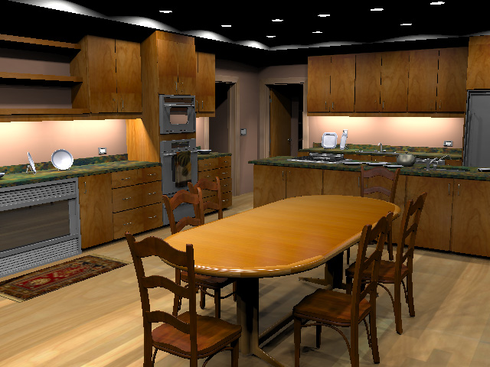
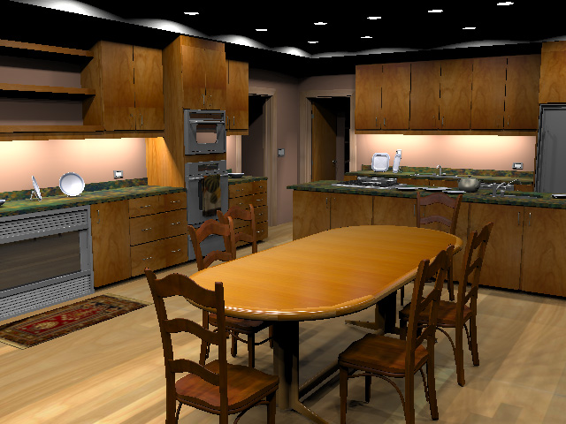
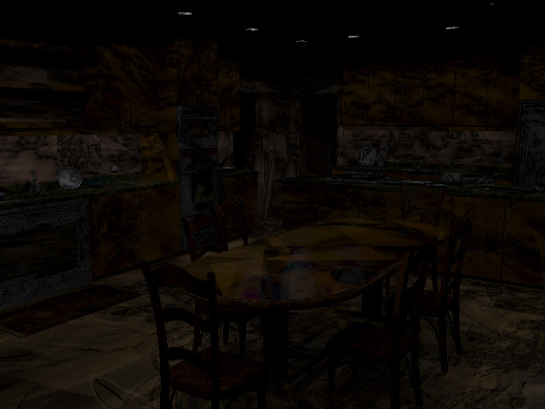
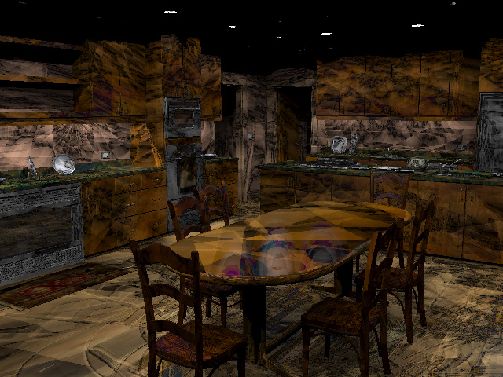
Lightcuts (128s)
Reference (1096s)
Error
Error x16
Kitchen, 388K polygons, 4608 lights (72 area sources)
Notes:
We can compute a error image on the left which is very dark and then magnify the differences by a factor of 16 to see the types of error introduced. What we see are lots discontinuity lines which are the transitions between using a particular cluster and refining it.

Slide 38
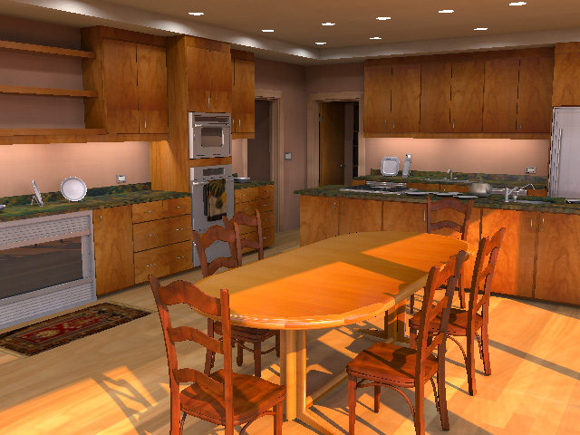
Combined Illumination
Lightcuts 128s
4 608 Lights
(Area lights only)
Avg. 259 shadow rays / pixel
Lightcuts 290s
59 672 Lights
(Area + Sun/sky + Indirect)
Avg. 478 shadow rays / pixel
(only 54 to area lights)
Notes:
We can also use lightcuts to compute much more complex illumination. On the right we have added both sun/sky and indirect illumination to create a much richer image. Although we have increased the number of point lights by over a factor of 10, the total time increased by only a factor of just over 2.
The number of shadow rays also increased by about a factor of 2. However image on left used an average of 259 shadow rays to the area lights, the image on the right used on 54. Our system automatically uses the presence of the other illumination to allow a coarser approximation of the area lights.

Slide 39
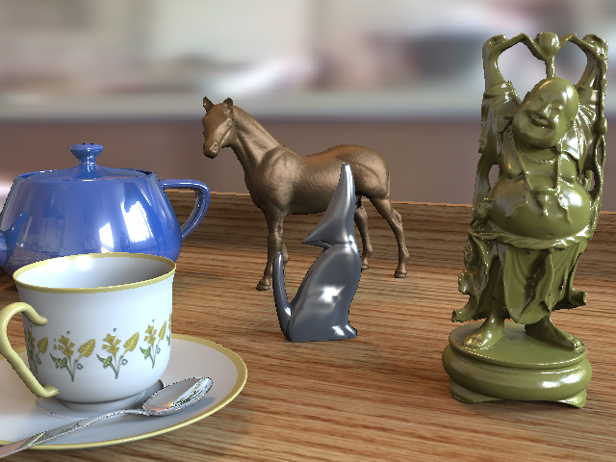
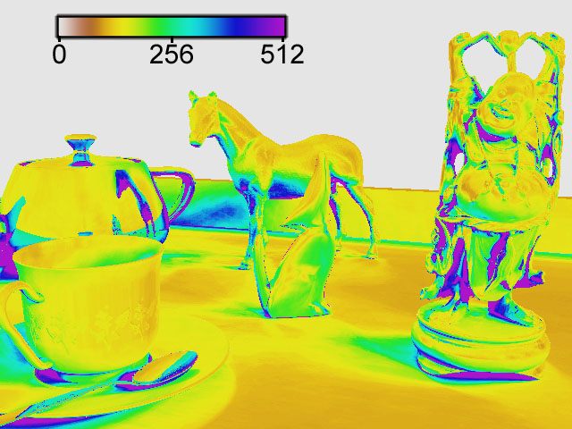
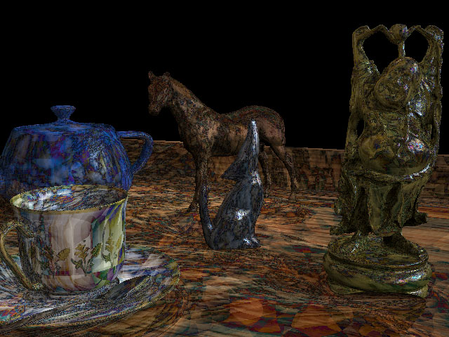
Lightcuts
Reference
Cut size
Error x 16

Slide 40
Scalable
Scalable solution for many point lights
  Thousands to millions
  Sub-linear cost
Tableau Scene
Kitchen Scene

Slide 41
Why does it work so well?
Data-driven stratification & importance sampling
Stratification
  Clustering of similar lights in the light tree
Importance sampling
  Subdividing clusters with high contribution

Slide 42
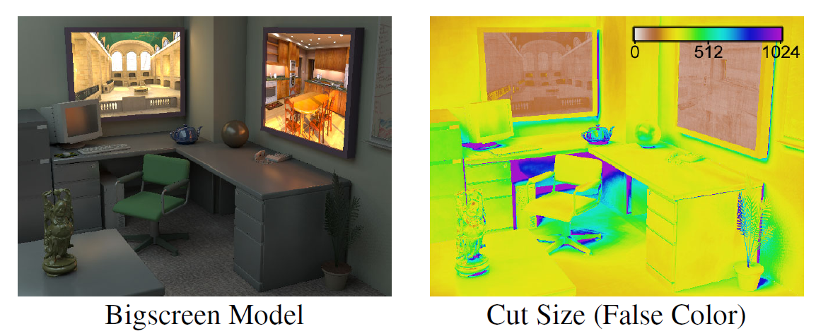
Main issue
Problem: Large cuts in dark areas

Slide 43
Lightcuts Recap
Key ingredients
  Upper bound on error
  Refinement of the highest-error nodes first
Notes:
I’ve presented lightcuts, which is a unified framework for handling complex illumination. Its core is a new scalable solution for handling many lights and a locally adaptively illumination approximation called the cut. It is based on analytic cluster error bounds that guarantee that we will always sample the most important lights and a perceptual visibility metric. There are more details in the paper and you can come see our implementation sketch this afternoon. If you do read the paper, I recommend that you look at an electronic version as several of the figures were printed incorrectly in the printed proceedings.

Slide 44

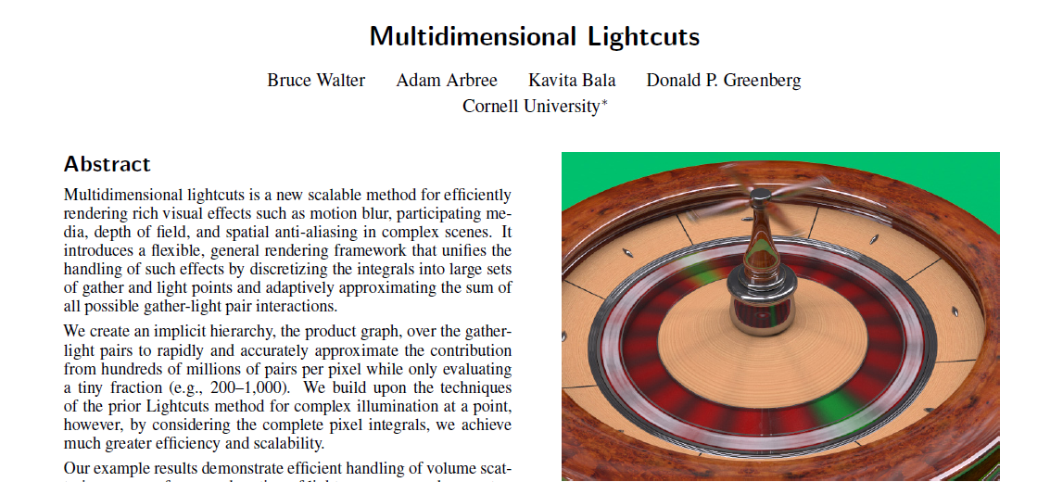
Multidimensional Lightcuts
http://www.graphics.cornell.edu/~bjw/papers.html

Slide 45
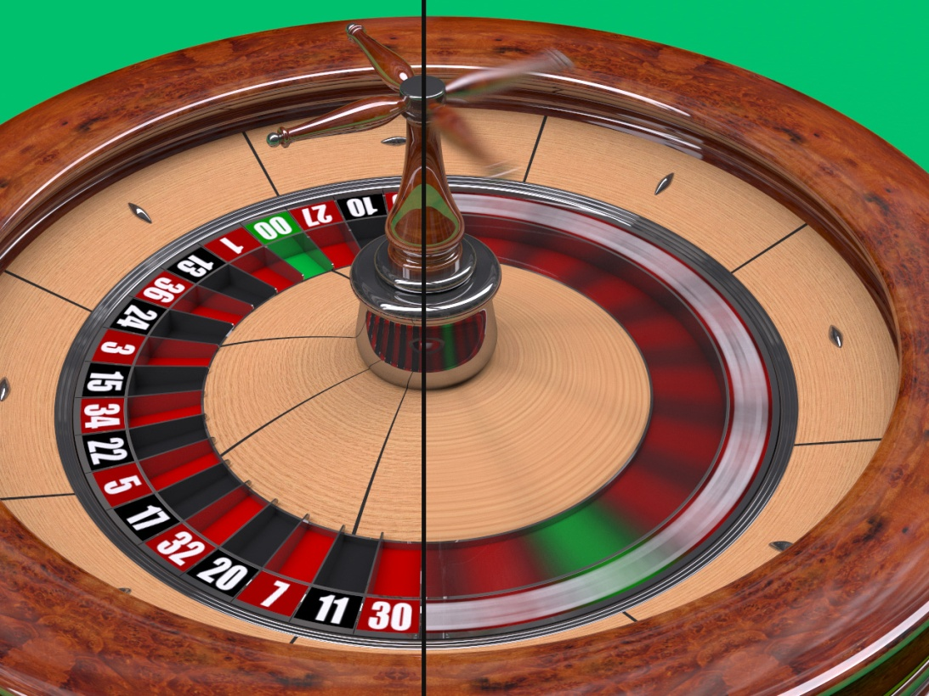
Problem
Simulate complex, expensive phenomena
  Complex illumination
  Anti-aliasing
  Motion blur
  Participating media
  Depth of field
Notes:
Let me first describe the problem we’re trying to solve. In order to compute high quality realistic images we need to be able to simulate multiple complex expensive phenomena. For instance the image on the right includes complex illumination, both from a captured environment map and indirect illumination, plus anti-aliasing and, on the right side of the image, motion blur for the spinning roulette wheel. Thus for each pixel we need to integrate the contribution over multiple domains.

Slide 46
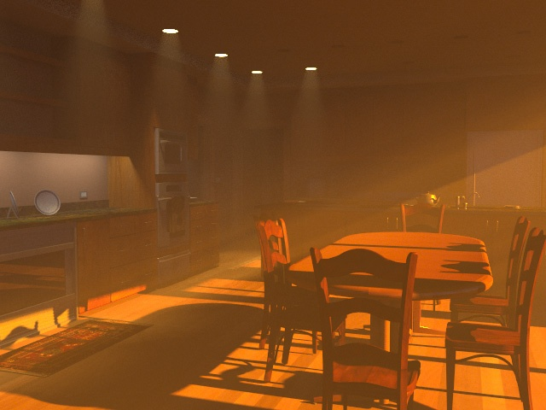
Problem
Simulate complex, expensive phenomena
  Complex illumination
  Anti-aliasing
  Motion blur
  Participating media
  Depth of field
Notes:
If we also want to include participating media then we also need to integrate over the volume of the scene. For example in this smoky kitchen scene which shows shafts of sunlight streaming into the kitchen.

Slide 47
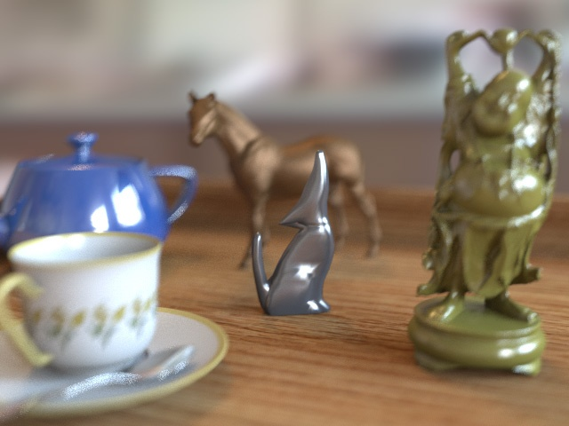
Problem
Simulate complex, expensive phenomena
  Complex illumination
  Anti-aliasing
  Motion blur
  Participating media
  Depth of field
Notes:
And if we want to add depth of field or camera focus such as shown in this scene then we need to also integrate over the aperture of the camera.

Slide 48
Problem
Complex integrals over multiple dimensions
  Requires many samples
camera
Notes:
The result is that to compute each pixel we need to integrate over multiple complex domains as illustrated here. This requires computing a large number of samples which are transport paths from the lights to the camera.

Slide 49
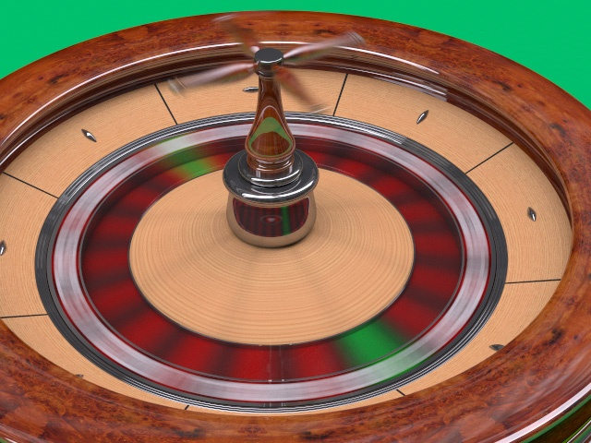
Multidimensional Lightcuts
Solves all integrals
simultaneously
Accurate
Scalable
Notes:
In this talk, I describe our new unified rendering solution called multidimensional lightcuts. By solving all the integrals simultaneously our solution is able to achieve superior scalability. An example of our scalability is shown on the right. We varied the number of temporal sample per pixel in our roulette scene and show how this relates to image time. With traditional approaches like supersampling the cost increases rapidly with the number of temporal samples whereas the cost in our new multidimensional technique show sublinear scaling and allows us to compute high quality motion blur at a much lower cost.

Slide 50
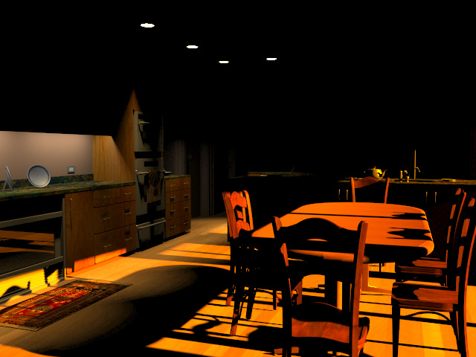
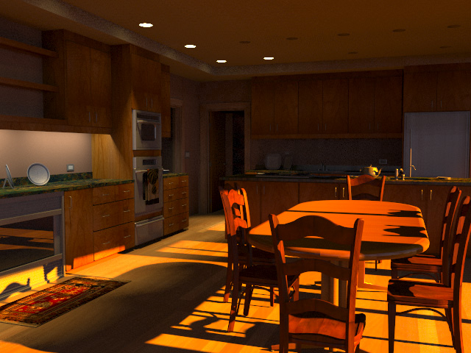
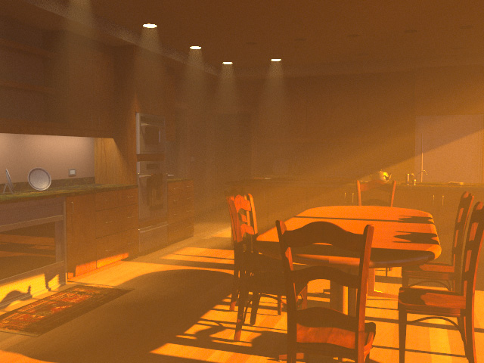
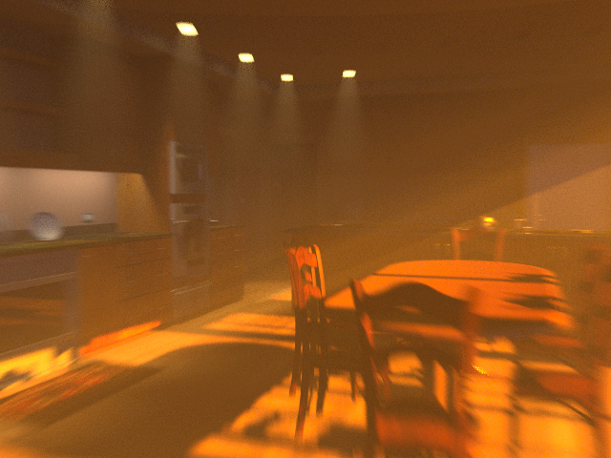
Direct only (relative cost 1x)
Direct+Indirect (1.3x)
Direct+Indirect+Volume (1.8x)
Direct+Indirect+Volume+Motion (2.2x)
Notes:
This example shows another way in which our system is scalable. We take a single scene and progressively add more and more complex effects. Thus the image on the upper left is a direct only solution for the area lights and sun. The image on the upper right also include indirect illumination. The image on the lower left also added smoke or participating media to the scene and finally the image on the lower right further adds motion blur. Even though this image includes multiple complex effects its rendering time only increases by a factor of 2.2 compared to the direct only solution which is much better than in traditional approaches where adding each effect would greatly increase the image time.

Slide 51
Point Sets
Discretize full integral into 2 point sets
  Light points (L)
  Gather points (G)
Light points
Camera
Notes:
So now let’s describe how our system works. We discretize the full integral equation using two point sets. First we convert all the light sources in the scene to point light approximations.

Slide 52
Point Sets
Discretize full integral into 2 point sets
  Light points (L)
  Gather points (G)
Light points
Camera
Notes:
We also trace particles from the light to create additional light points that account for the effect of indirect illumination.

Slide 53
Point Sets
Discretize full integral into 2 point sets
  Light points (L)
  Gather points (G)
Light points
Pixel
Camera
Gather points
Notes:
Then for each pixel we trace rays from the camera through the pixel to generate gather points. Note that these point can be generated over time, over the volume, camera aperture, etc. to account for the different integral domains.

Slide 54
Point Sets
Discretize full integral into 2 point sets
  Light points (L)
  Gather points (G)
Light points
Gather points
Notes:
The the set of all gather-light pairs forms a very large set of transport paths that can accurate approximate the full integral.

Slide 55
Discrete Equation
Sum over all pairs of gather and light points
  Can be billions of pairs per pixel
Σ
Pixel = S_{j} M_{ji} G_{ji} V_{ji} I_{i}
( j,i) ∈ G^{x}L
Material term
Visibility term
Gather strength
Geometric term
Light intensity
Notes:
Here is the discretized equation. I won’t cover all the detail here, they are in the paper. However you should note that we converted all the integrals over multiple domains into a single summation over pairs of gather and light points. Also there may be a very large number of these pairs. If we generate a thousand gather points per pixel and a million light points then the sum would be over a billion pairs per pixel. It would be prohibitively expensive to evaluate the full sum and so instead we need a way to accurate approximate the sum while only actually evaluating a much smaller number of pairs.

Slide 56
Product Graph
Explicit hierarchy would be too expensive
  Up to billions of pairs per pixel
Use implicit hierarchy
  Cartesian product of two trees (gather & light)
Notes:
So let me now describe the product graph. Since we could have up to billions of pairs per pixel, explicitly constructing a hierarchy over them would be too expensive. Instead we are going to create an implicit hierarchy via the cartesian product of two trees, the gather tree and the light tree.

Slide 57
Product Graph
L1
L2
L6
L3
L0
L4
L5
L0
L1
L2
L3
Light tree
G1
G0
G2
G0
G1
Gather tree
Notes:
So first we generate all the light points and cluster them together into a light tree. Then for each pixel we generate the gather points and cluster them together into a gather tree.

Slide 58
Product Graph
L6
Product Graph
L4
L5
L2
G0
L0
L1
L3
=
Light tree
G2
X
G1
G2
L0
L4
L1
L6
L2
L5
L3
G0
G1
Gather tree
Notes:
Then we can use these trees to define the product graph which forms a hierarchy over the set of all gather-light pairs. Each node in the product graph corresponds to pairing of one node from the light tree and one node from the gather tree.

Slide 59
Product Graph
L6
Product Graph
L4
L5
L2
G0
L0
L1
L3
=
Light tree
G2
X
G1
G2
L0
L4
L1
L6
L2
L5
L3
G0
G1
Gather tree
Notes:
For example the source node of the product graph corresponds to the pairing of the root node of the light tree and the root node of the gather tree.

Slide 60
Product Graph
Product Graph
G0
G2
G1
L0
L4
L1
L6
L2
L5
L3
Notes:
In the scene this corresponds to combining all the light points into a single cluster, combining all the gather points into a single cluster and then treating the set of all pairs as just a single interaction between these clusters. In general that is not going to be an accurate enough approximation of the pixel value, so we need a way to refine this approximation.

Slide 61
Product Graph
Product Graph
G0
G2
G1
L0
L4
L1
L6
L2
L5
L3
Notes:
For example we can split the lights into two clusters and then treat the set of all pairs as two interactions. One between the gather points and the light cluster on the left and the other between the gather points and the light cluster on the right. This corresponds to moving along the blue arrows in the product graph. It also corresponds to moving one step down in the light tree.

Slide 62
Product Graph
L6
Product Graph
L4
L5
L2
G0
L0
L1
L3
=
Light tree
G2
X
G1
G2
L0
L4
L1
L6
L2
L5
L3
G0
G1
Gather tree
Notes:
We could also have refine the interaction by moving one step down in the gather tree (ie splitting the gather cluster) which corresponds to the green arrows in the product graph. A key thing to note here is that we do not ever have to actually create the product graph. Instead we can implicitly traverse the product graph by simultaneously walking both the light and gather trees. And thus we never actually instantiate the product graph. Now that we have a way to defining and refining clusters of pairs, we need an inexpensive way to approximate a cluster.

Slide 63
Cluster Representatives
Notes:
For example if we want to estimate the contribution of all these gather-light pairs.

Slide 64
Cluster Representatives
Notes:
We do this by choosing representative. We pick one of the light to be the represenative light and similarly one representative gather point. Then we approximate all the gather-light pairs using just the single pair of the representative gather point and the representative light point. We also need a way to bound the error introduced by this approximation.

Slide 65
Error Bounds
Collapse cluster-cluster interactions to point-cluster
  Minkowski sums
  Reuse bounds
  from Lightcuts
Compute maximum over multiple BRDFs
  Rasterize into cube-maps
More details in the paper
Notes:
The details of the error bounding is in the paper, but I’ll just review two important components here. First we’re able to reduce the problem of cluster to cluster interactions into point to cluster interactions using Minkowski sums. Essentially we shrink one bound box to a point while simultaneously expanding the other bounding box. Once we applied this transformation we can then reuse a lot of bounding machinery from the Lightcuts paper last year. Also each point has a directional distribution associated with it such as a BRDF and we need to be able to compute maximums for this distributions over many points. We reduce all these distribution to a common form by rasterizing them into cube maps and then we can easily combine them and compute maximums. Again the details are in the paper.

Slide 66
Algorithm Summary
Once per image
  Create lights and light tree
For each pixel
  Create gather points and gather tree for pixel
  Adaptively refine clusters in product graph until
  all cluster errors < perceptual metric
Notes:
So now let us summarize our algorithm. Once per image, we generate the set of light points and cluster them into a light tree. Then for each pixel we generate gather points and cluster them into a gather tree. Then we start with a coarse cut in the product graph and adaptively refine it until the each node’s error is less than our perceptual metric.

Slide 67
Scalability
Start with a coarse cut
  Eg, source node of product graph
L0
L4
L1
L6
L2
L5
L3
G0
G2
G1
Notes:
For example we can start with the coarsest cut which is simply the source node of the product graph.

Slide 68
Scalability
Choose node with largest error bound & refine
  In gather or light tree
L0
L4
L1
L6
L2
L5
L3
G0
G2
G1
Notes:
Then at each step we choose the node with the largest error bound and refine it by moving one step down in either the gather tree or the light tree. In this example we’ve chosen to move one step down in the light tree.

Slide 69
Scalability
Choose node with largest error bound & refine
  In gather or light tree
L0
L4
L1
L6
L2
L5
L3
G0
G2
G1
Notes:
Then we repeat the process.

Slide 70
Scalability
Repeat process
L0
L4
L1
L6
L2
L5
L3
G0
G2
G1
Notes:
Select the node with the largest error bound and refine it, in this case we chosen to refine by moving one step down in the gather tree.

Slide 71
Algorithm summary
Until all clusters errors < perceptual metric
  2% of pixel value (Weber’s law)
L0
L4
L1
L6
L2
L5
L3
G0
G2
G1
Notes:
We keep refining until all node in the cut have error bounds less than our perceptual metric, which is 2% of the estimated pixel value and is based on Weber’s law.

Slide 72
Results
Limitations
  Some types of paths not included
    Eg, caustics
  Prototype only supports diffuse, Phong, and Ward materials and isotropic media
Notes:
Before showing you some results let me mention some of the limitations of our system. We do not currently handle some types of transport paths such as caustics. Also our implementation only supports a limited set of materials, namely diffuse, phong, ward materials, and isotropic media.

Slide 73
Roulette
7,047,430 Pairs per pixel Time 590 secs
Avg cut size 174 (0.002%)
Notes:
This is our roulette example which highlight motion blur. Here we are using 256 temporal samples per pixel for an average of over 7 million potential pairs per pixel. However the cut size is only 174 which means that we only actually evaluated 174 pairs which is only a tiny fraction of all the pairs. This allowed us to compute this image in just under 10 minutes on a single machine which very fast for this scene.

Slide 74
Scalability
Notes:
Here we again show the scalability graph for the roulette scene for increasing numbers of gather points. We also show the time just to compute the eye rays and generate the gather points in purple.

Slide 75
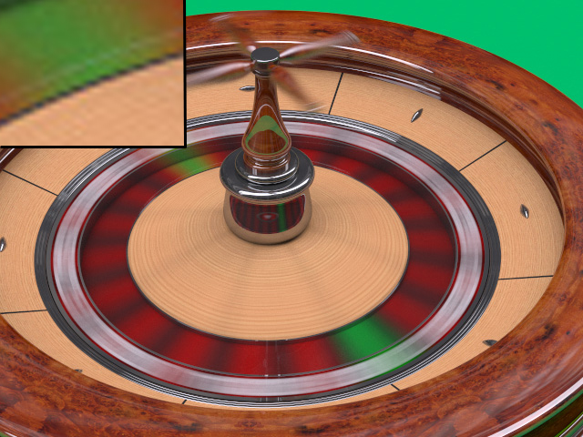
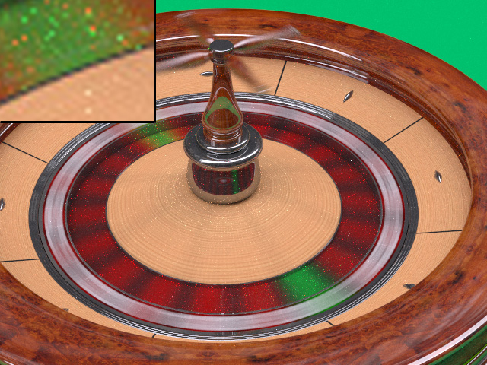
Metropolis Comparison
Zoomed insets
Our result
Time 9.8min
Metropolis
Time 148min (15x)
Visible noise
5% brighter (caustics etc.)
Notes:
Here we show a comparison between our results and an image computed using Metropolis. Overall the image are very similar but there are two main differences. First the Metropolis result is on average 5% brighter because it includes some types of transport paths such as caustics that we don’t handle. But the main difference is that even though we let the Metropolis result run for fifteen times longer there is still some visible noise in the Metropolis result.

Slide 76
Kitchen
5,518,900 Pairs per pixel Time 705 secs
Avg cut size 936 (0.017%)
Notes:
This kitchen result highlights our handling of participating media. Here we have a potential 5.5 million pairs per pixel but on average we only actually evaluated 936 pairs per pixel which again is only a tiny fraction of all pairs. This allows us to compute this complex image in only just under 12 minutes on a single machine.

Slide 77
180 Gather points X 13,000 Lights = 234,000 Pairs per pixel
Avg cut size 447 (0.19%)

Slide 78
Scalable many-light rendering
Matrix Row-Column sampling
Hašan et al., SIGGRAPH 2007
Slides courtesy Miloš Hašan:
http://www.cs.cornell.edu/~mhasan/

Slide 79
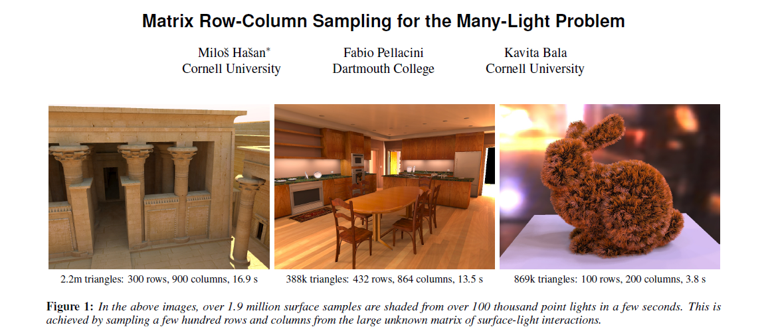
Matrix Row-Column sampling
http://miloshasan.net/
Designed specifically for GPU rendering (shadow mapping)

Slide 80
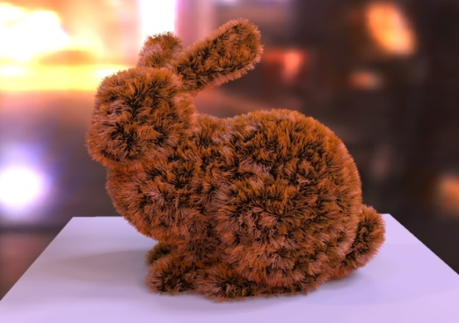
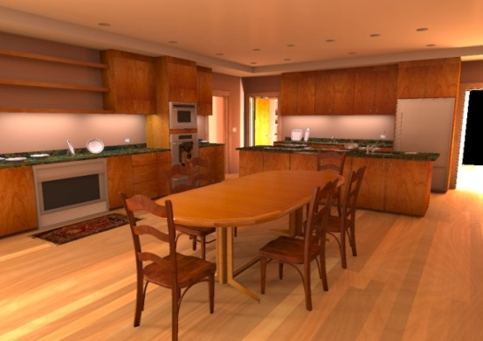
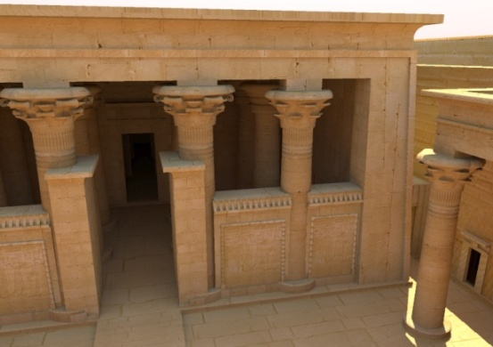
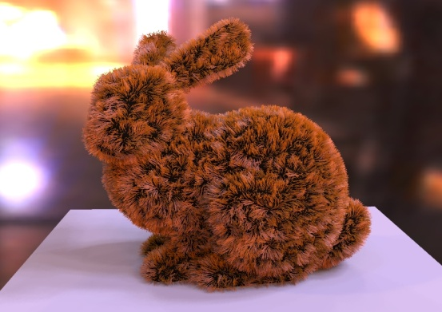
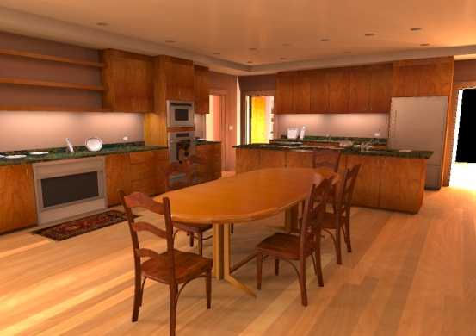

Improving Scalability and Performance
Brute force
(100k VPLs)
10 min
13 min
20 min
MRCS
(our result)
3.8 sec
13.5 sec
16.9 sec
Notes:
Our algorithm reduces the rendering times from minutes to seconds. as you can see in the bottom row of images
This approach could have compelling applications, for example in lighting design.

Slide 81
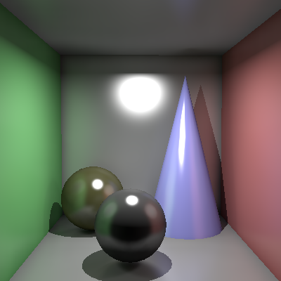
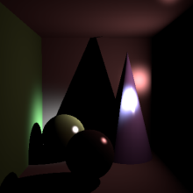
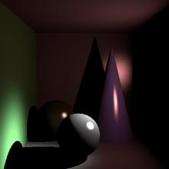
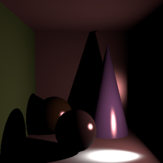
A Matrix Interpretation
Lights (100,000)
Pixels
(2,000,000)
Notes:
We can interpret the many light problem as a matrix of light-pixel interactions.
This means that each element of the matrix is the contribution of a single light to a single pixel.
So, the columns of the matrix are really images rendered with a single point light.
The rows represent contributions of all the lights to a particular pixel.

Slide 82
Problem Statement
Compute sum of columns
Lights
= Σ (
)
Pixels
Notes:
In this setting, the ideal image we would like to render is equal to the sum of the columns of the matrix.
Or, to put it differently, the color of each pixel is equal to the sum of the matrix row corresponding to that pixel.

Slide 83

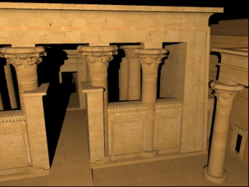
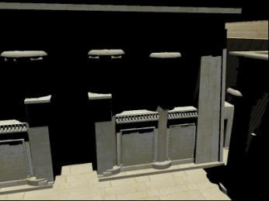
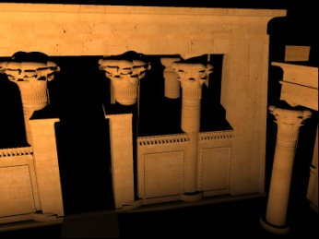
Low-Rank Assumption
Column space is (close to) low-dimensional
Lights
= Σ (
)
Pixels
Notes:
The first insight that makes our result possible is as follows.
Let’s take the simple scene on the left, and look at the matrix corresponding to the illumination in the scene.
We can see that the matrix is highly structured. Numerically, it is usually close to low-rank.
Therefore, we can get away with computing only a very small subset of the elements, and still gather enough information to render an accurate image.

Slide 84
Ray-tracing vs Shadow Mapping
Lights
Pixels
Point-to-many-points visibility: Shadow-mapping
Point-to-point visibility: Ray-tracing
Notes:
So, we want to sample a subset of the elements, but which ones should we choose?
If we sample like this, we’ll have to use ray-tracing to evaluate the visibility term between lights and pixels.
However, if we sample complete rows and columns, we can use GPU shadow mapping as our visibility algorithm.
This way we can compute elements at a much higher rate.

Slide 85
Computing Column Visibility
Regular Shadow Mapping
Lights
Pixels
1 shadow map
Shadow map at light position
Surface samples
Notes:
In particular, we can compute the shadow map at light position, and determine the visibility of the surface samples, as usual.

Slide 86
Row-Column Duality
Rows: Also Shadow Mapping!
Lights
Pixels
1 shadow map
Shadow map at sample position
Notes:
We can also invert this idea and compute the shadow map at the surface sample, and determine the visibility of all lights.

Slide 87

Image as a Weighted Column Sum
The following is possible:
Lights
Pixels
Compute small subset of columns
(i.e. pick some lights)
compute weighted sum
Use rows to choose a good set of columns (=lights)
Notes:
It’s usually possible to find a very small subset of the columns such that some linear combination of them is a very good approximation to the ideal result.
If we only knew which subset it is, and what are the weights!
But, given that we know nothing about the matrix up front, it seems impossible to guess this subset.
However, there is a solution: compute a subset of rows, and use them to choose a good set of columns and weights.

Slide 88
The Row-Column Sampling Idea
Lights
Pixels
?
compute rows
(i.e. pick pixels, compute contrib from ALL lights for each)
how to choose columns and weights?
choose columns (=lights) and weights
compute columns
(i.e. for the selected lights, compute contribution to all pixels)
weighted sum
Notes:
This leads us to the idea of designing our algorithm as a combination of exploration and exploitation.
As a first step, we explore the structure of the matrix by computing a small, randomly chosen subset of rows.
Next, we analyze the gathered information, and decide which columns to choose and their appropriate weights.
The exploitation step then computes the selected columns, which are finally accumulated into an image.
So, this is the whole algorithm, except for the black box that analyzes the rows and chooses the columns.

Slide 89
Clustering Approach
Choose representative columns
Columns
Clustering
Notes:
We decide to use the following approach to choosing columns.
We cluster similar reduced columns, and we pick a representative in each cluster.
The accuracy of the algorithm is highly dependent on the quality of the clustering, so we should design the clustering algorithm carefully.

Slide 90



Reduced Matrix
Reduced columns
Notes:
First, let’s take the rows that we computed in the exploration stage,
And assemble them into this long, but not very tall reduced matrix.
Now let’s flip attention to the columns of this matrix, which we’ll call reduced columns.
These can in fact be thought of as tiny images that are sub-sampled versions of the full columns.

Slide 91
Monte Carlo Estimator
Algorithm:
  Cluster reduced columns
  Choose a representative in each cluster, with probability proportional to weight
  Approximate other columns in cluster by (scaled) representative
This is an unbiased Monte Carlo estimator
(of the sum of matrix columns)
Which clustering minimizes its variance?

Slide 92
Weights and Information Vectors
Weights w_{i}
  Norms of reduced columns
  Represent the “energy” of the light
Information vectors x_{i}
  Normalized reduced columns
  Represent the “kind” of light’s contribution
Notes:
We’ll also refer to the norms of reduced columns as “weights”, and call normalized reduced columns information vectors.

Slide 93
Visualizing the Reduced Columns
Reduced columns: vectors in high-dimensional space
visualize as …
radius = weight
position = information vector
Notes:
First, let’s think about the reduced columns as vectors in a high-dimensional space.
We’re going to visualize these high-dimensional vectors as circles.
The radius of each circle will correspond to the norm of the reduced column, or equivalently, to the brightness of the little image.
The positions will correspond to the positions of normalized reduced columns in the high-dimensional space.
With a bit of simplification, we can say that circles that are close to each other represent similar lights , and large circles represent lights with strong intensity.

Slide 94
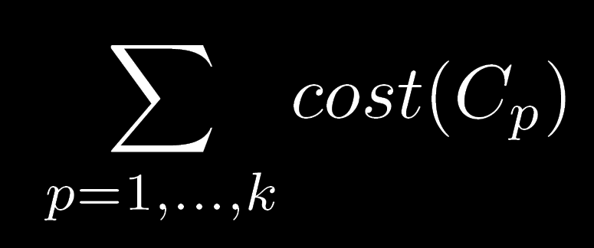
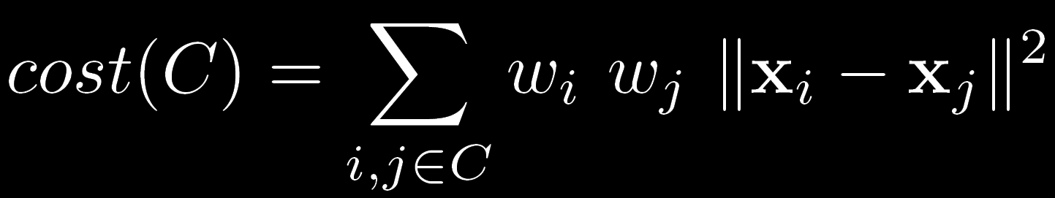
The Clustering Objective
Minimize:
where:
total cost of all clusters
weights
squared distance between information vectors
cost of a cluster
sum over all pairs in it
Notes:
In the paper, we prove that this formula gives the optimal clustering that minimizes the expected error.
So let’s look at its meaning. We’re minimizing the sum of costs of all clusters,
Where the cost of a cluster is defined as the sum over all pairs of elements in the cluster
of the product of norms and squared distance.
This confirms the intuition that strong lights, or lights that are far from each other, should be in separate clusters.

Slide 95
Clustering Illustration
Columns with various intensities can be clustered
Strong but similar columns
Weak columns can be clustered more easily
Notes:
For example, consider this configuration of reduced columns.
An ideal clustering would look like this.
Intuitively, weak columns don’t matter so much, so we can cluster them more aggressively.
But we would like to cluster strong columns only if they are very similar.
Note that We can cluster columns with different intensities as long as they’re close to each other.

Slide 96
How to minimize?
Problem is NP-hard
Not much previous research
Should handle large input:
  100,000 points
  1000 clusters
We introduce 2 heuristics:
  Random sampling
  Divide & conquer
Notes:
Now that we know which formula to minimize, we’d like to know how to do it.
Unfortunately, this problem is NP-hard, like many other combinatorial optimization problems.
Moreover, there’s not much existing research on it.
We also need a solution that’s very fast, since our input size is large, and we don’t want to spend the majority of rendering time in clustering.
So What do we do?

Slide 97
Clustering by Random Sampling
Very fast (use optimized BLAS)
Some clusters might be too small / large
Notes:
We can use this random sampling idea:
Pick some points using a suitable probability distribution to act as centers.
The assign all remaining points to the closest centers.
This can be made very fast, but sometimes we might undersample or oversample certain areas.

Slide 98
Clustering by Divide & Conquer
Splitting small clusters is fast
Splitting large clusters is slow
Notes:
Another possibility is a divide & conquer algorithm.
Here we pick a plane with a random orientation. Remember this is in many dimensions, here I’ll just visualize it as a line.
Then we move the plane to its optimal position and split the points into two clusters. There are only n possibilities so we can check them all to find the best one.
We then continue this process recursively on the cluster with the currently highest cost.

Slide 99
Combined Clustering Algorithm
Notes:
We found that combining these two algorithm works better then any of them by itself.
So let’s say we want to partition these points into eight clusters.
We can find,, let’s say, 5 clusters by random sampling…

Slide 100
Combined Clustering Algorithm
Notes:
… and then split 3 time to reach 8 clusters.
So this is our clustering algorithm. We found it pretty efficient.
100

Slide 101

Full Algorithm
Lights
Pixels
Assemble rows into reduced matrix
Cluster reduced columns
Compute rows (GPU)
Choose representatives
Weighted sum
Compute columns (GPU)
Notes:
So here’s the full algorithm:
In the exploration stage, we evaluate some rows on the GPU, then focus on the reduced columns.
We obtain a clustering through the techniques I just described, then pick representatives.
Finally, we accumulate the columns into an image.

Slide 102
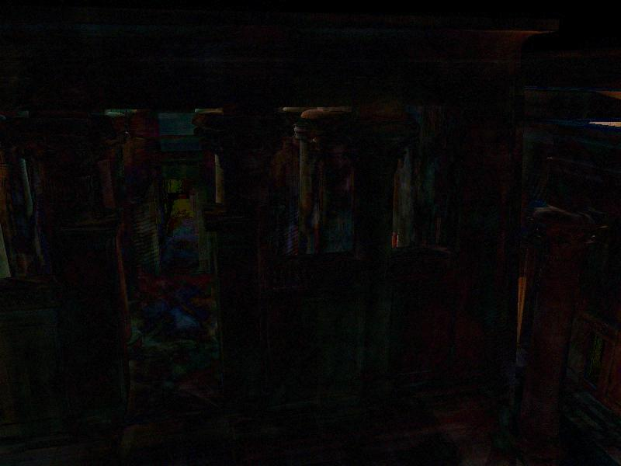

Example: Temple
2.1m polygons
Mostly indirect & sky illumination
Indirect shadows
5x diff
Our result: 16.9 sec
(300 rows + 900 columns)
Reference: 20 min (using all 100k lights)
Notes:
The temple is our largest scene, not only in terms of the number of polygons, but also its spatial extent. In fact, only a tiny portion of the scene is in view.
Most of the illumination in the scene is indirect or sky illumination.
Also note the detailed indirect shadows on the fine geometry of the pylons.

Slide 103
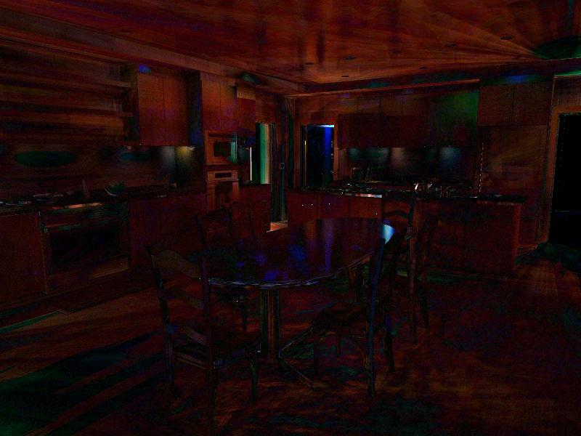

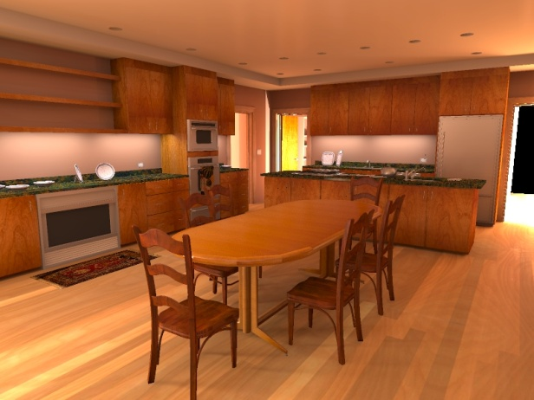
Example: Kitchen
388k polygons
Mostly indirect illumination
Glossy surfaces
Indirect shadows
5x diff
Our result: 13.5 sec
(432 rows + 864 columns)
Reference: 13 min
(using all 100k lights)
Notes:
Most of the illumination in this kitchen scene is indirect.
There are a few direct light sources positioned behind the corners and not directly visible to the camera.
Most of the materials have a glossy component.
Indirect shadows are handled accurately.

Slide 104
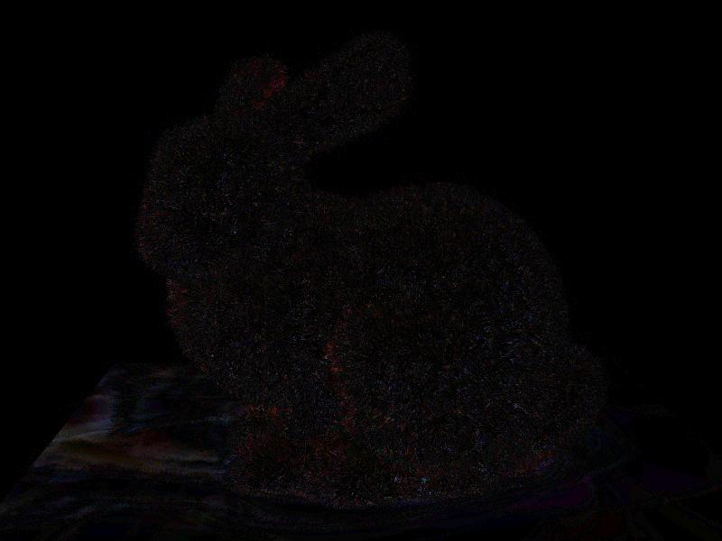

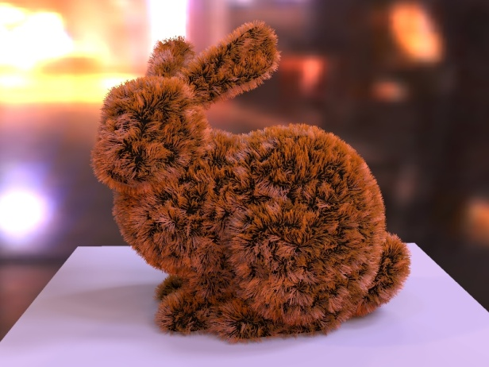
Example: Bunny
869k polygons
Incoherent geometry
High-frequency lighting
Kajiya-Kay hair shader
5x diff
Our result: 3.8 sec
(100 rows + 200 columns)
Reference: 10 min
(using all 100k lights)
Notes:
The bunny image shows that our algorithm can handle complexity and incoherence both in geometry and in lighting.
Also note that the Kajiya Kay hair shader, showing that arbitrary shaders can be incorporated into our framework.

Slide 105


Effect of exploration
#VPLs = 250k, # cols = 10k
# rows = 300
28 sec
# rows = 900
35 sec
Too few VPLs

Slide 106

Comparison
Lightcuts (2M VPLs)
30 sec
MRCS (250k VPLs)
35 sec

Slide 107
Why does it work so well?
  Data-driven stratification & importance sampling
  Same reason as for Lightcuts
Stratification
  Split clusters with dissimilar lights
Importance sampling
  Split clusters with high-contribution lights

Slide 108
Comparison to Lightcuts
Advantage
  Takes visibility into account in light selection (reduced matrix contains the full light contributions)
Drawback
  Impossible to capture localized effects
    Low likelihood of getting the right row sample
    Global light selection

Slide 109
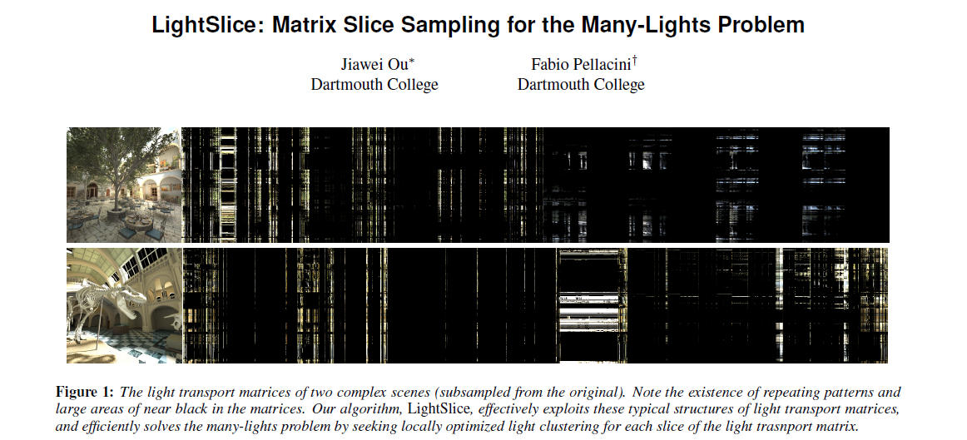

LightSlice
http://www.cs.dartmouth.edu/~fabio/publication.php?id=lightslice11

Slide 110
LightSlice: Idea
Get the better from Lightcuts and MRCS
  Lightcuts: Localized selection of relevant lights
  MRCS: Take visibility into account in light selection

Slide 111

LightSlice: The Algorithm
Cannot use shadow maps for row/column sampling
Clustering borrowed from the original MRCS paper

Slide 112

LightSlice: Matrix Slices
Matrix slice
visualization
Image

Slide 113

LightSlice: Results
Not really a fair comparison to MRCS
(uses ray traced visibility)

Slide 114

Importance Caching
Localized light (VPL) selection taking visibility into account

Slide 115
Importance Caching: Algorithm
Importance caching
  Pick image pixels (2000 - 3000)
  For each such pixel, compute and cache contributions from all lights (i.e. matrix row)
Image rendering
  For each image pixel
    Collect nearby importance records
    Pick a VPL proportional to the cached contributions

Slide 116

Cached light importance
Contributions to
the record location
of individual lights
Importance record 1
Importance record 2
Importance record 3

Slide 117

Possible problems
OK
Occlusion
Geometry factor
Irrelevant

Slide 118

Solution: Multiple importances
Full light contribution
Unoccluded contribution
Uniform
distribution
Unoccluded contribution
w/ bounded G-term

Slide 119
Distribution combination
Multiple importance sampling (MIS)
  See CG III slides
  http://cgg.mff.cuni.cz/~jaroslav/teaching/2011-pg3/slides/krivanek-07-npgr010-2011-mc2.pptx
New combination heuristic proposed in the paper

Slide 120

Results

Slide 121




Results: A 2-second rendering

Slide 122
Importance Caching: Limitations
Fewer initial VPLs than any of the previous algorithms (up to 10k)
  Because of memory limitations
  Must run in iterations if more VPLs needed
No data-driven stratification

Slide 123
Take-home message
Data-driven importance sampling may be dangerous
  Non-zero contribution may be sampled with very low, or even zero probability
  Being conservative is safer, but can reduce the advantage of data-driven IS
  For more information see [Owen & Zhou 2000] http://citeseerx.ist.psu.edu/viewdoc/summary?doi=10.1.1.36.2813

Slide 124
How ‘bout Lightcuts and MRCS?
MRCS
  In theory suffers from the same problem, but
  light importance averaged over full columns, so it works ok
  BTW: Why do you think there’s global clustering in LightSlice ☺
Lightcuts
  Has upper bounds so it knows which lights can be safely skipped

Slide 125
Scalable many-light methods
Lightcuts [Walter et al 05/06]
Matrix Row Column Sampling [Hašan et al. 07]
LightSlice [Ou & Pellacini 2011]
Importance caching [Georgiev et al. 2012]

Slide 126
Improved VPL distribution
[Segovia et al. 07]: Metropolis instant radiosity
  http://www710.univ-lyon1.fr/~jciehl/bsegovia/bat710/public_html/papers/mir.html
  Use Metropolis sampling to guide the VPL where they can contribute to the image
[Georgiev & Slussalek 2010]
  http://www.iliyan.com/p/publications.html
  Use rejection sampling to reject VPLs that do not contribute significantly

